Slide 1
Making sense of the data
PRELIMINARY
REPORT
2018 LISTENING SESSIONS

Slide 2
Process
Divide the congregation into affinity groups
Schedule and complete listening sessions
Analyze data for common themes, and sentiment
One remaining session 4/9
This report does not include 3/11 session
Notes:
Was their response positive, negative, neutral?
What was the core topic mentioned?

Slide 3
Process
Divide the congregation into affinity groups
Schedule and complete listening sessions
Analyze data for common themes, and sentiment
One remaining session 4/9
This report does not include 3/11 session

Slide 4
Process – What’s next?
Ensure the representative affinity groups have been interviewed
Complete analysis
Make final recommendations – vision statement foundation
Report to the congregation

Slide 5
Affinity Groups
 | COMPLETED | IN REPORT
Faith Bible Discovery
Four Retirement Facilities
Men’s Breakfast
Mission and Outreach Teams
New Members 2016-17
Sanctuary Choir
Youth
Youth Parents
Families
Young Adults

Slide 6
Process – What’s next?
Ensure the representative affinity groups have been interviewed
Complete analysis
Make final recommendations – vision statement foundation
Report to the congregation

Slide 7
Welcoming All
LET’S DIG IN

Slide 8
Welcoming All
Adjectives you would use to describe PHPC?
Adjectives a person outside PHPC would use to describe PHPC?
Your first memory of feeling welcomed at PHPC or another church?
What is the most significant thing PHPC gives you?

Slide 9

Welcoming All
Notes:
Overall positive
Negative: Status Quo, Lost, Cold, Not Diverse
Positive: 272
66 open and welcoming
25 Community

Slide 10
Welcoming All
OPEN AND WELCOMING
24%
COMMUNITY
9%
Notes:
Overall positive
Negative: Status Quo, Lost, Cold, Not Diverse
Positive: 272
66 open and welcoming
25 Community

Slide 11

Welcoming All
Status Quo
Lost
Cold
Not Diverse
Notes:
Status Quo can be positive or negative. These are negative attributes.
***from one affinity group

Slide 12
Welcoming All
SENTIMENTS
2/3 Negative comes from one class
Youth and their Parents are overwhelmingly positive
skew
Notes:
Observations
2/3 of negative sentiment from one class
Youth and their Parents are overwhelmingly positive (recent transition)
What PHPC gives you:
Community 18/40
Adjectives
Open and Welcoming 40/182
Active 14/182
Cold 12/182 **

Slide 13
Welcoming All
What PHPC gives you
Adjectives
Open and
Welcoming
22%
45%
Active - 8%
Cold – 7%*
Community
Notes:
Observations
2/3 of negative sentiment from one class
Youth and their Parents are overwhelmingly positive (recent transition)
What PHPC gives you:
Community 18/40
Adjectives
Open and Welcoming 40/182
Active 14/182
Cold 12/182 **

Slide 14
Welcoming All
What PHPC gives you
Adjectives
Open and
Welcoming
22%
45%
Active - 8%
Cold – 7%*
Community
Notes:
Observations
2/3 of negative sentiment from one class
Youth and their Parents are overwhelmingly positive (recent transition)
What PHPC gives you:
Community 18/40
Adjectives
Open and Welcoming 40/182
Active 14/182
Cold 12/182 **

Slide 15
Welcoming All
What PHPC gives you
Adjectives
Community
Open and Welcoming
45%
Active
Cold
Notes:
Observations
2/3 of negative sentiment from one class
Youth and their Parents are overwhelmingly positive (recent transition)
What PHPC gives you:
Community 18/40
Adjectives
Open and Welcoming 40/182
Active 14/182
Cold 12/182 **

Slide 16
Transforming the World
LET’S DIG IN

Slide 17
Transforming the World
What’s an area of need in the world?
Could/should PHPC address it?

Slide 18
Transforming the World
Area of Need
Where
Race
9%
Education
10%
Local
Poverty
39%
Notes:
Most people were not specific about scope and scale (79 unknown) – when they were, it was very clear LOCAL
Poverty 39/118
Education 13/118
Race 12/118
Local 34/39
National 1/39
Global 4/39

Slide 19
Transforming the World
Area of Need
Where
Race
9%
Education
10%
Local
Poverty
39%
Notes:
Poverty 39/118
Education 13/118
Race 12/118
Local 34/39
National 1/39
Global 4/39
Most people were not specific about scope and scale (79 unknown) – when they were, it was very clear LOCAL

Slide 20
Transforming the World
Area of Need
Where
Race
Local
Education
Poverty
Notes:
Poverty 39/118
Education 13/118
Race 12/118
Local 34/39
National 1/39
Global 4/39
Most people were not specific about scope and scale (79 unknown) – when they were, it was very clear LOCAL

Slide 21
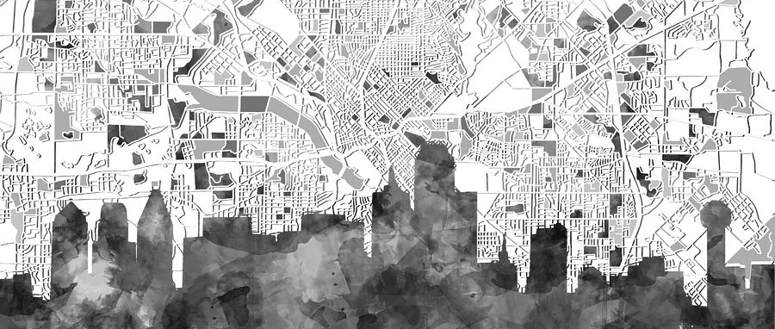
Transforming DALLAS

Slide 22
Growing Disciples
LET’S DIG IN

Slide 23
Growing Disciples
What hymns, stories, or scriptures inform your faith?
What growth opportunities would you like to participate in?

Slide 24
Growing Disciples
What hymns, stories, or scriptures inform your faith?
Song
38%
Scripture
35%

Slide 25
Growing Disciples
What growth opportunities would you like to participate in?
Prayer
16%
Worship
21%
Song
38%
Study
20%
Service
40%
Scripture
35%

Slide 26
Growing Disciples
What they are doing
What they want to do more of
Prayer
16%
Worship
21%
Song
38%
Study
20%
Scripture
35%
Service
40%

Slide 27
Growing Disciples
What they are doing
What they want to do more of
Demographic Observations
35%
Prayer
New Members
Worship
Service
Song
38%
22%
22%
Youth
Prayer
Scripture
Study
38%
Service
Scripture
35%
Service
Notes:
The majority of the congregation is fairly inline with these percentages. Two interesting standouts.

Slide 28
Dream or Prayer for PHPC
LET’S DIG IN

Slide 29
Dream or Prayer for PHPC
Family/Youth/Young Adults
22%
Welcoming
11%
Service and Mission
10%
Attendance and Growth
10%
Notes:
Family/Youth/Young Adult has historically been used in conjunction with Attendance and Growth = Vibrant
***Youth and their parents did not skew data

Slide 30
Dream or Prayer for PHPC
Attendance and Growth
10%
Family/Youth/Young Adults
22%
Welcoming
11%
Service and Mission
10%
Notes:
Family/Youth/Young Adult has historically been used in conjunction with Attendance and Growth = Vibrant
***Youth and their parents did not skew data

Slide 31



Dream or Prayer for PHPC
VIBRANT & DIVERSE
ACTIVE & ENGAGED

Slide 32
2018
LISTENING SESSIONS
PRELIMINARY
REPORT

